Slide 1
Visual C#

Slide 2
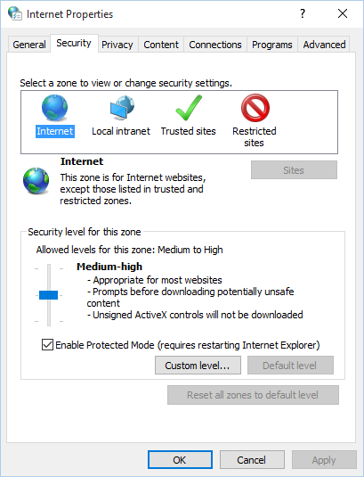
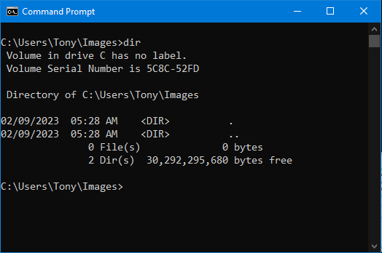
Graphical User Interface
User interfaces allow users to interact with the computer. Categories are:
Command line interface (aka console interface)
Graphical user interface (G U I)- now the most commonly used

Slide 3
Objects
Most programming languages use object-oriented programming in which a program component is called an “object”
Program objects have properties (or fields) and methods
Properties – data stored in an object
Methods – the operations an object can perform

Slide 4
Controls
Objects that are visible in a program G U I are known as controls
Commonly used controls are Labels, Buttons, and TextBoxes
They enhance the functionality of your programs
There are invisible objects in a G U I such as Timers, and OpenFileDialog
A class is code that describes a particular type of object

Slide 5
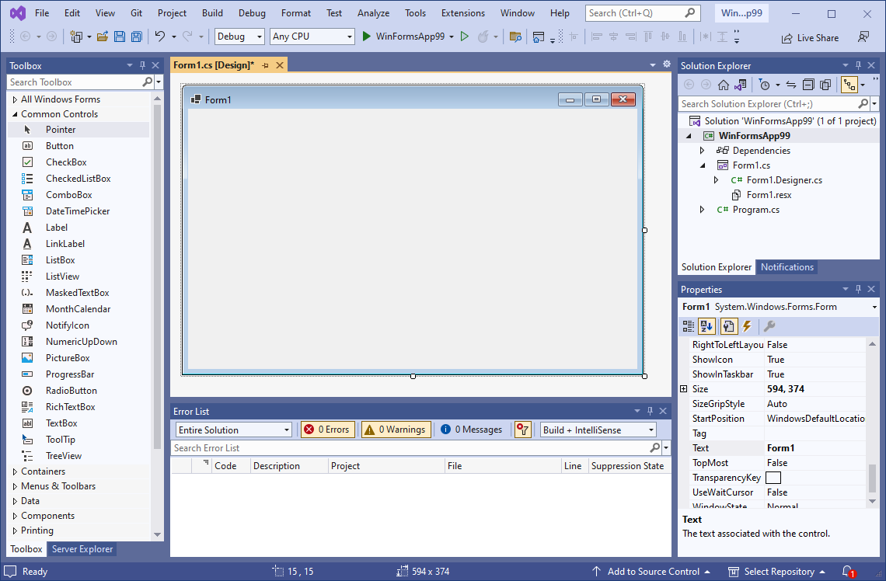
Getting Started with Forms and Controls
When you start a new C# Windows Forms App, an empty form named Form1 is automatically created.
Empty form

Slide 6
The Form’s Bounding Box and Sizing Handles
A form in Designer is enclosed with thin dotted lines called the bounding box
The bounding box has small sizing handles; you can use them to resize the form

Slide 7
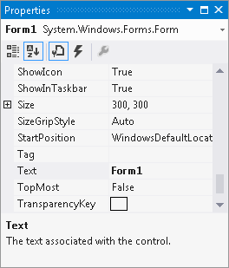
The Properties Window
The appearance and other characteristics of a G U I object are determined by the object's properties
The Properties window lists all properties
When selecting an object, its properties are displayed in Properties windows
Each property has 2 columns:
Left: property’s name
Right: property’s value

Slide 8
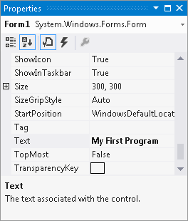
Changing a Property’s Value
Select an object, such as the Form, by clicking it once
Click View and select Properties if the Properties window is not available
Find the property’s name in the list and change its value
The Text property determines the text to be displayed in the form’s title bar
Example: Change the value from “Form1” to “My First Program”

Slide 9
Adding Controls to a Form
In the Toolbox, select the Control (e.g. a Button), then you can either:
double click the Button control
click and drag the Button control to the form
On the form, you can
resize the control using its bounding box and sizing handles
move the control’s position by dragging it
change its properties in the Properties window

Slide 10
Rules for Naming Controls
Controls’ are identified by their names in code
The naming rules are:
The first character must be a letter (lower or uppercase, does not matter) or an underscore (_)
All other characters can be alphanumerical characters or underscores
The name cannot contain spaces
Examples of valid names are:
showDayButton
DisplayTotal
_ScoreLabel

Slide 11
Source Code in the Solution Explorer
Each time a new WinForms app project is created the following two source code files are automatically created:
Program.cs contains the application’s start up code to be executed when the application runs
Form1.cs contains code that is associated with the Form1 form

Slide 12
Organization of the Form1.cs
A sample of Form1.cs:
The user defined namespace of the project
Class declaration
A method

Slide 13
Adding Your Code
GUI applications are event driven which means they respond to events that occur while the application is running
An event is a user’s action such as mouse clicking, key pressing, etc.
In the Designer, double clicking a control such as Button will link the control to a default Event Handler
An event handler is a method that executes when a specific event takes place
A code segment similar to the following will be created automatically:
private void myButton_Click(object sender, EventArgs e)
{
}

Slide 14
Message Boxes
A message box (aka dialog box) displays a message
.NET provides a method named MessageBox.Show
The method displays a window with a message. A sample code is (bold line):
Placing it in the myButton_Click event handler can display the string in the message box when the button is clicked
private void myButton_Click object sender, EventArgs e)
{
MessageBox.Show("Thanks for clicking the button!");
}

Slide 15
Label Controls
A Label control displays text on a form and can be used to display unchanging text or program output
Commonly used properties are:
Text: gets or sets the text associated with Label control
Name: gets or sets the name of Label control
Font: allows you to set the font, font style, and font size
BorderStyle: allows you to display a border around the control’s text
AutoSize: controls the way they can be resized
TextAlign: set the text alignments

Slide 16
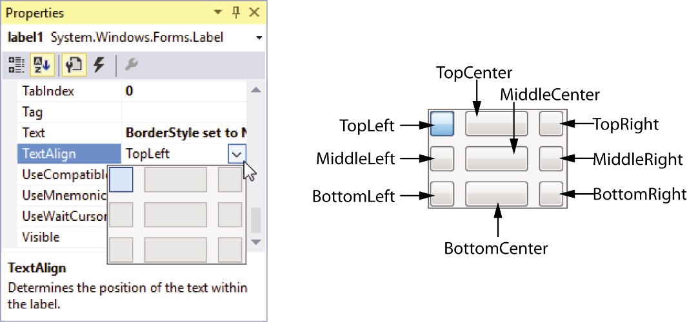
Handling Text Alignments
The TextAlign property supports the following values:
You can select them by clicking the down arrow button of the TextAlign property
TopLeft | TopCenter | TopRight
MiddleLeft | MiddleCenter | MiddleRight
BottomLeft | BottomCenter | BottomRight

Slide 17
Using Code to Display Output in a Label Control
By adding the following bold line to a Button's event handler, a Label control can display output of the application.
Notice that
the equal sign (==) is known as assignment operator
the item receiving the value must be on the left of the operator
the Text property accepts a string only
if you need to clear the text of a Label, simply assign an empty string ("""") to clear the Text property
private void showAnswerButton_Click(object sender, EventArgs e)
{
answerLabel.Text = "Theodore Roosevelt";
}

Slide 18
PictureBox Controls
A PictureBox control displays a graphic image on a form
Commonly used properties are:
Image: specifies the image that it will display
SizeMode: specifies how the control’s image is to be displayed
Visible: determines whether the control is visible on the form at run time

Slide 19
Creating Clickable Images
You can double click the PictureBox control in the Designer to create a Click event handler and then add your codes to it. For example,
And
private void catPictureBox_Click object sender, EventArgs e)
{
MessageBox.Show("Meow");
}
private void spiderPictureBox_Click object sender, EventArgs e)
{
spiderPictureBox.Visible = false;
}

Slide 20
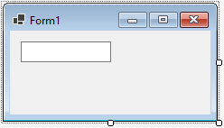
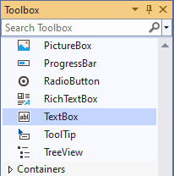
Reading Input with TextBox Control
TextBox control
a rectangular area
can accept keyboard input from the user
located in the Common Control group of the Toolbox
double click to add it to the form
default name is textBoxn
where n is 1, 2, 3, …

Slide 21
The Text Property
A TextBox control’s Text property stores the user inputs
Text property accepts only string values, e.g.
To clear the content of a TextBox control, assign an empty string(“”)
textBox1.Text = “Hello”;
textBox1.Text = “”;

Slide 22
The Text Property
A TextBox control’s Text property stores the user inputs
Text property accepts only string values, e.g.
To clear the content of a TextBox control, assign an empty string(“”)
textBox1.Text = “Hello”;
textBox1.Text = “”;

Slide 23
Tab Order
When an application is running, one of the form’s controls always has the focus
Focus means a control receives the user’s keyboard input
When a button has the focus, pressing the Enter key can execute the button’s Click event handler
The order in which controls receive the focus is called the tab order
When the user presses the tab key to select controls, the program will follow the tab order
The TabIndex property contains a numeric value indicating the control’s position in the tab order
The value starts with 0. The index of first control is 0, the nth control is n 1

Slide 24
Tab Order
To set the tab order of a control, click Tab Order on the View menu. This activates the tab order selection mode on the form.
Simply click the controls with the mouse in the order you want.
Notice that Label controls do not accept input from the keyboard. They cannot receive focus.
Their TabIndex values are irrelevant

Slide 25
Tab Order
You can use the Focus method to change the focus using the following syntax:
The following changes the focus to nameTextBox when the user clicks the Clear button:
ControlName.Focus();
private void clearButton_Click object sender, EventArgs e)
{
nameTextBox.Focus();
}

Slide 26
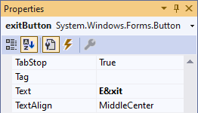
Assign Keyboard Access Key to Buttons
An access key (or mnemonic) is a key that is pressed in combination with the Alt key to quickly access a control
You can assign an access key to a button’s Text property by adding an ampersand (&) before a letter
The user can use the keystrokes Alt + X or Alt + x.
An access key does not distinguish between uppercase and lowercase
E&xit

Slide 27
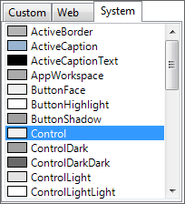
Setting Colors
Forms and most controls have a BackColor property
Controls that can display Text also have a ForeColor property
These color related properties support a drop-down list of colors
The list has tree tabs:
Custom: display a color palette
Web: list colors displayed with consistency in Web browsers
System: list colors defined in current Windows
You can set colors in color
The .NET Framework provides numerous values that represent colors
messageLabel.BackColor = Color.Black;
messageLabel.ForeColor = Color.Yellow;

Slide 28
Background Images for Forms
A Form has a property named BackgroundImage that is similar to the Image property of a PictureBox.
Simply import an image to the Select Resource window
A Form also has a BackgroundImageLayout property that is similar to the SizeMode property of a PictureBox.
Choose from one of the following options

Slide 30
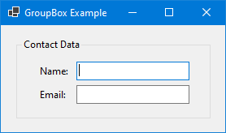
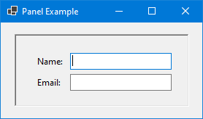
GroupBoxes vs Panels
A GroupBox control is a container with a thin border and an optional title that can hold other controls
A Panel control is also a container that can hold other controls
There are several primary differences between a Panel and GroupBox:
A panel cannot display a title and does not have a Text property, but a GroupBox supports these two properties.
A panel’s border can be specified by its BorderStyle property, while the GroupBox cannot be

